Slide 1

Eco-Resilient Networks Smart Deployment for the Future
Activity 4: (SCRUM) Check-in # 3
Muhammad Hamza Shahab
Syed Haider Abbas Naqvi
24th March 2025
Researching and Engineering Community Centred Software
Notes:
Brief intro - "Good morning, we're presenting our progress on the Eco-Resilient Networks project."

Slide 2



Connection with Course Concepts
Digital Habitats:
Our simulation is a tool within the digital habitat of network engineers, supporting their practice.
Community Orientations:
The Tradeoff-Aware embedding policy allows for flexibility, catering to different community orientations.
Technology & Community:
We're balancing reification (network optimization) with participation (data for decisions), adding sustainability.
Technology Stewardship:
We're acting as technology stewards by creating a useful, usable, and aligned tool.
Knowledge Management:
Our simulation generates knowledge from data, aiding decision-making.
Open Source:
Following CC (creative commons) model and making our simulation framework open source. Free to share, free to adapt.
Notes:
We identified key gaps in the current technology: a lack of focus on sustainability and limited optimization capabilities.

Slide 3
Project Progress
Section | Status | Notes
MVP 2: Algorithm Implementation & Evaluation | On Track | Significant progress made on embedding policies, optimization, and performance evaluation.
Work Package 2.1: Embedding Policy Implementation | ✅ Completed | Implemented Availability-Aware, Carbon-Aware, and Tradeoff-Aware policies.
Work Package 2.2: Redundancy Optimization (PSO – Particle Swarm Optimization) | ✅ Completed | Integrated PSO with embedding policies.
Work Package 2.3: Performance Metric Calculation | ✅ Completed | Implemented availability, carbon footprint, and latency calculations.
Work Package 2.4: Algorithm Comparison & Evaluation | ✅ Completed | Extensive simulations are executed along with the analysis of results and generation of comparison reports.
Work Package 2.5: Other Optimization Algorithms (SA – Simulated Annealing & GA – Genetic Algorithm) | 🟡 In Progress | Implementation of additional optimization algorithms is underway.
MVP 3: Documentation & Reporting | Ongoing | Documentation, user guide, and research paper drafting in progress.
Work Package 3.1: Code Documentation | 🟡 In Progress | Docstrings and comments being updated.
Work Package 3.2: User Guide | ✅ Completed | User Guide Draft is completed.

Slide 4
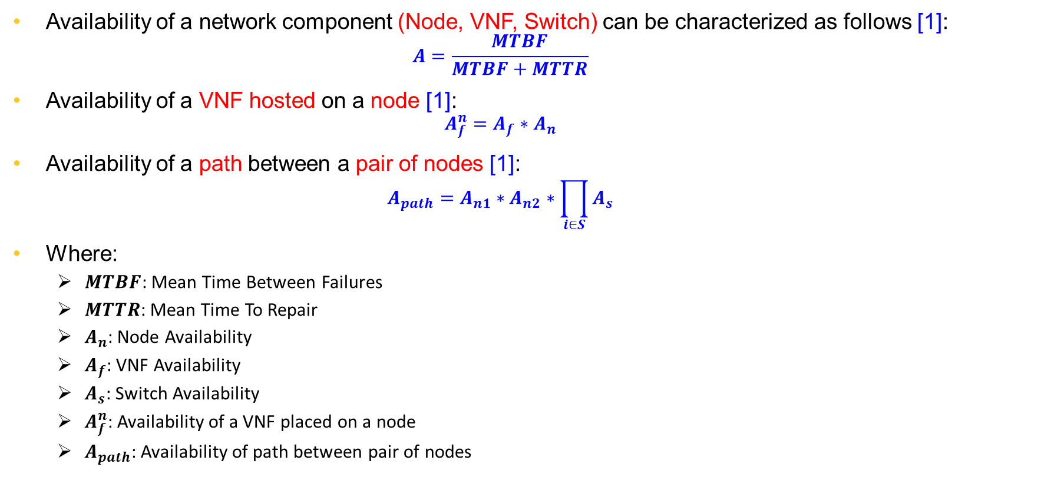
Availability Model
Availability of a network component (Node, VNF, Switch) can be characterized as follows [1]:
$$A=\frac{MTBF}{MTBF+MTTR}$$
Availability of a VNF hosted on a node [1]:
$$A_{f}^{n}=A_{f}∗A_{n}$$
Availability of a path between a pair of nodes [1]:
$$A_{path}=A_{n1}∗A_{n2}∗\prod_{i∈S}{A_{s}}$$
Where:
$MTBF$: Mean Time Between Failures
$MTTR$: Mean Time To Repair
$A_{n}$: Node Availability
$A_{f}$: VNF Availability
$A_{s}$: Switch Availability
$A_{f}^{n}$: Availability of a VNF placed on a node
$A_{path}$: Availability of path between pair of nodes

Slide 5
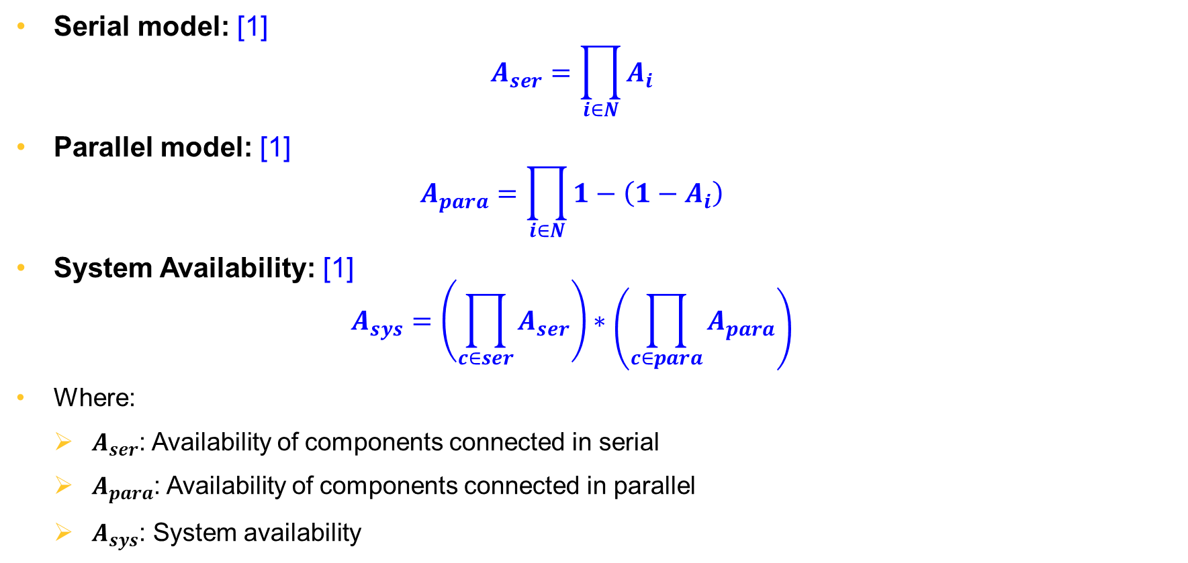
Availability Model (Cont.)
Serial model: [1]
$$A_{ser}=\prod_{i∈N}{A_{i}}$$
Parallel model: [1]
$$A_{para}=\prod_{i∈N}{1−\left(1−A_{i}\right)}$$
System Availability: [1]
$$A_{sys}=\left(\prod_{c∈ser}{A_{ser}}\right)∗\left(\prod_{c∈para}{A_{para}}\right)$$
Where:
$A_{ser}$: Availability of components connected in serial
$A_{para}$: Availability of components connected in parallel
$A_{sys}$: System availability

Slide 6
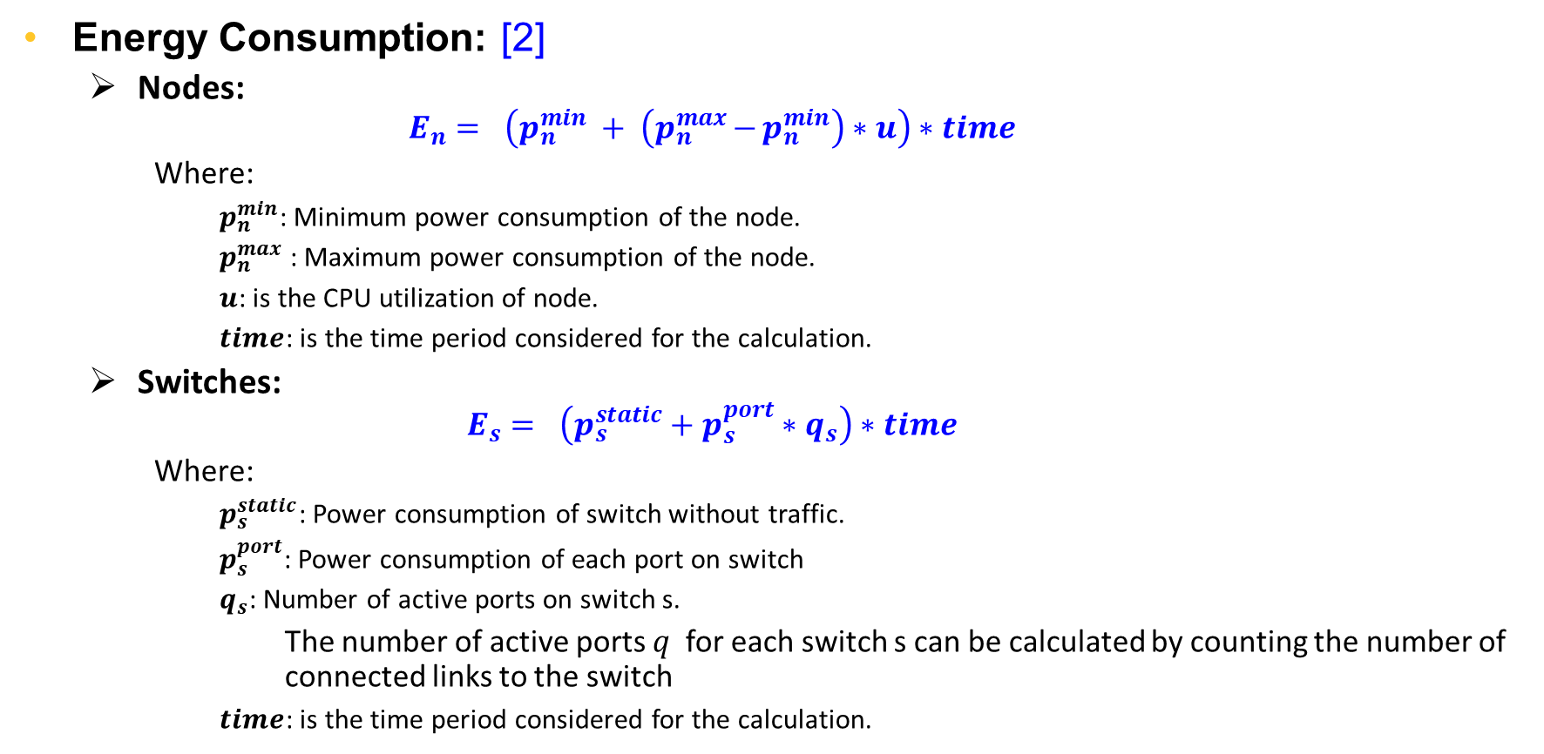
Carbon Footprint Model
Energy Consumption: [2]
Nodes:
$$E_{n}= \left(p_{n}^{min} + \left(p_{n}^{max}{−}p_{n}^{min}\right)∗u\right)∗time$$
Where:
$p_{n}^{min}$: Minimum power consumption of the node.
$p_{n}^{max}$: Maximum power consumption of the node.
$u$: is the CPU utilization of node.
$time$: is the time period considered for the calculation.
Switches:
$$E_{s}= \left(p_{s}^{static}+p_{s}^{port}∗q_{s}\right)∗time$$
Where:
$p_{s}^{static}$: Power consumption of switch without traffic.
$p_{s}^{port}$: Power consumption of each port on switch
$q_{s}$: Number of active ports on switch s.
The number of active ports 𝑞​ for each switch s can be calculated by counting the number of connected links to the switch
$time$: is the time period considered for the calculation.

Slide 7
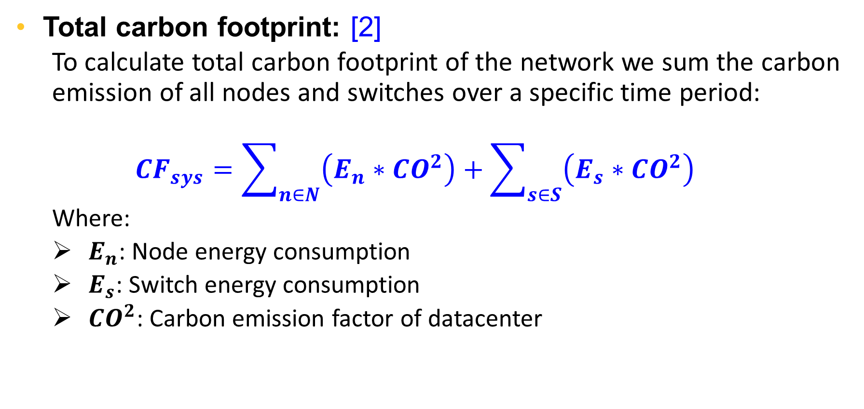
Carbon Footprint Model (cont.)
Total carbon footprint: [2]
To calculate total carbon footprint of the network we sum the carbon emission of all nodes and switches over a specific time period:
$${CF}_{sys}=\sum_{n∈N}{\left(E_{n}∗CO^{2}\right)}+\sum_{s∈S}{\left(E_{s}∗CO^{2}\right)}$$
Where:
$E_{n}$: Node energy consumption
$E_{s}$: Switch energy consumption
$CO^{2}$: Carbon emission factor of datacenter

Slide 8
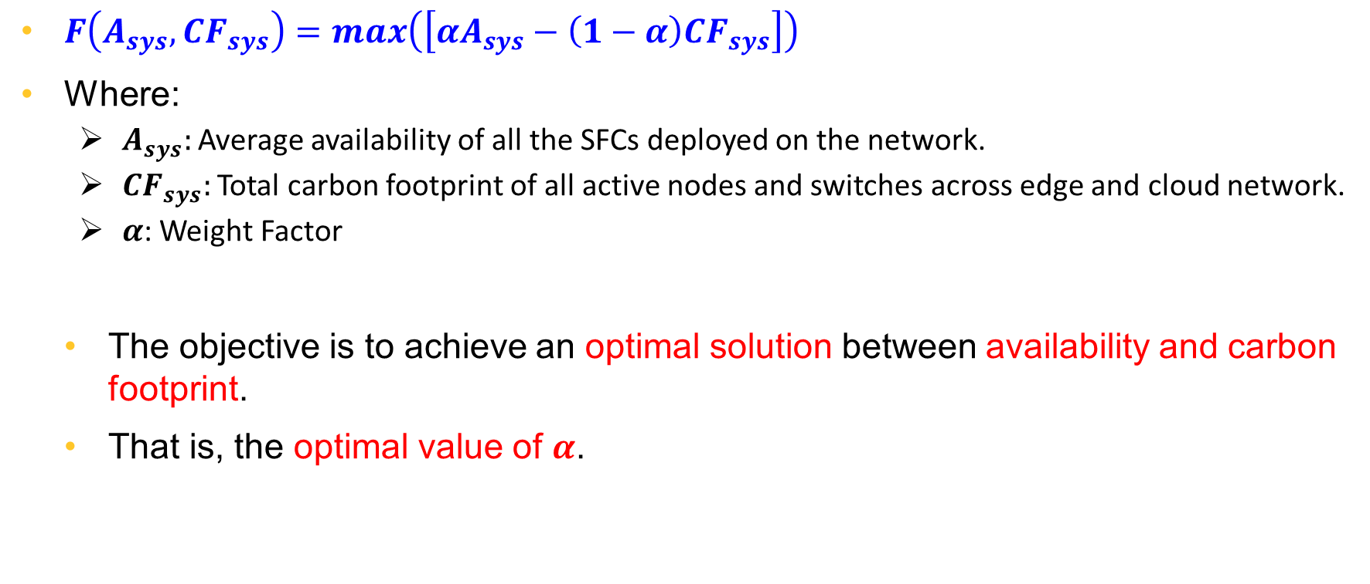
Objective Function
$F\left(A_{sys}, CF_{sys}\right)=max\left(\left[αA_{sys}−\left(1−α\right)CF_{sys}\right]\right)$
Where:
$A_{sys}:$ Average availability of all the SFCs deployed on the network.
$CF_{sys}:$ Total carbon footprint of all active nodes and switches across edge and cloud network.
𝜶: Weight Factor
The objective is to achieve an optimal solution between availability and carbon footprint.
That is, the optimal value of $α$.

Slide 9
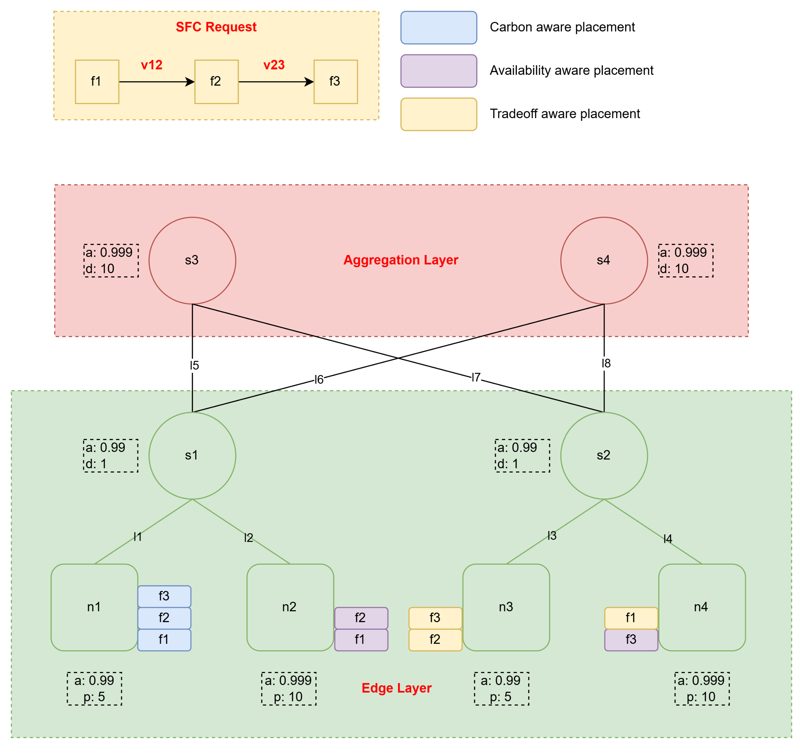
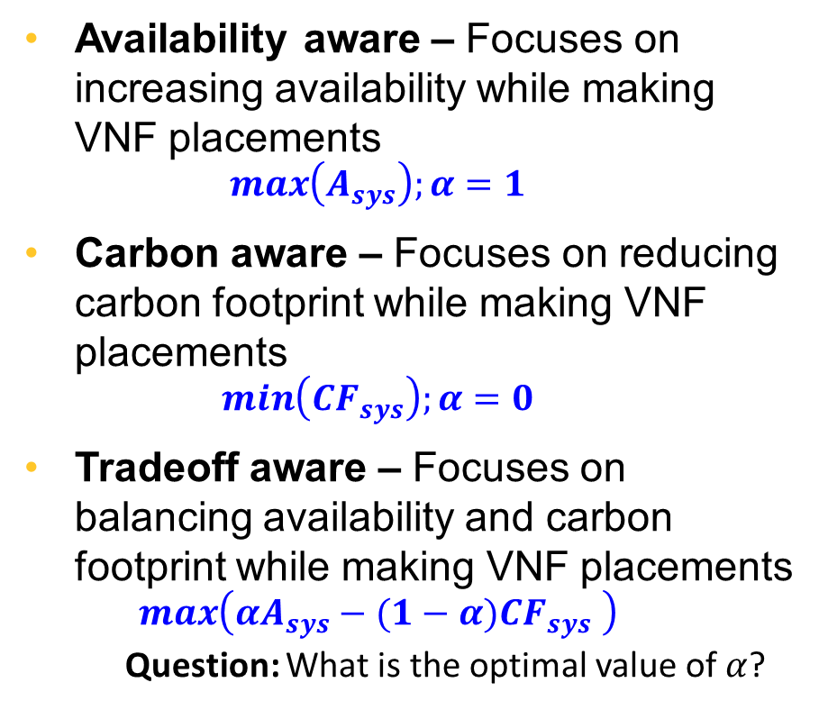
Network Placement Schemes
Availability aware – Focuses on increasing availability while making VNF placements
$$\max\left(A_{sys}\right);α=1$$
Carbon aware – Focuses on reducing carbon footprint while making VNF placements
$$\min\left({CF}_{sys}\right);α=0$$
Tradeoff aware – Focuses on balancing availability and carbon footprint while making VNF placements
$$\max\left(αA_{sys}−(1−α)CF_{sys} \right)$$
Question: What is the optimal value of $α$?

Slide 10
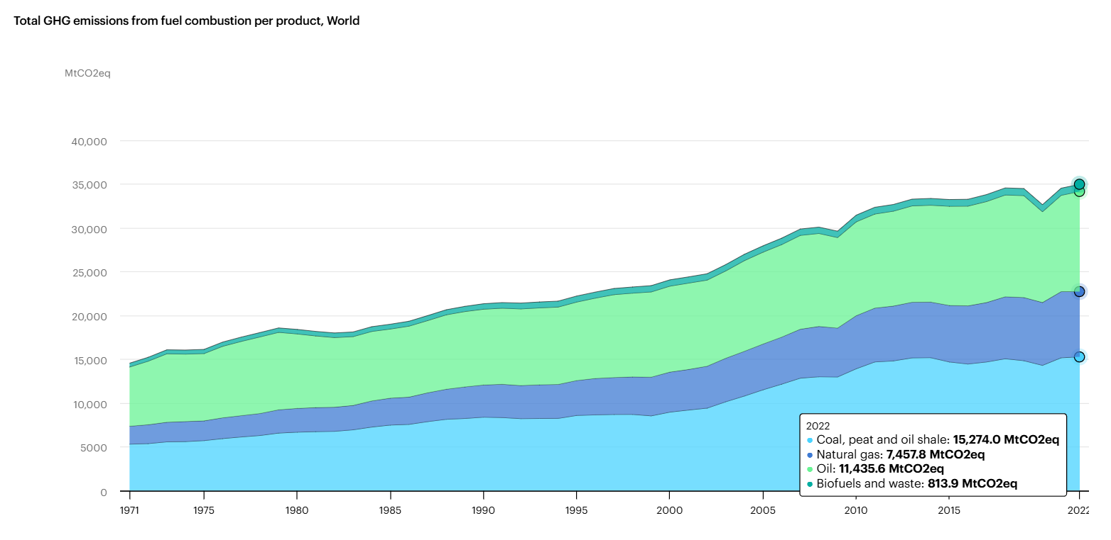
Energy Source Impact on Carbon Emissions [3]

Slide 11
Carbon Footprint Rate Sources
Table shows data centers’ PUE value and carbon footprint rates
The PUE value is based on the work by Greenberg et al. [4]
Carbon footprint rates, are extracted based on the information from US Department of Energy, Appendix F, Electricity Emission Factors. [5]
PUE (Power Usage Effectiveness):
Measures the energy efficiency of a data center.
It is calculated by dividing total energy consumption by the energy used for IT equipment.
Lower PUE values indicate better energy efficiency.
Data Center Site | PUE | Carbon Footprint Rate(Tons/MWh)
DC1 -Oregan, USA | 1.56 | 0.124
DC2 -California, USA | 1.7 | 0.350
DC3 -Virginia, USA | 1.9 | 0.466
DC4 -Dallas, USA | 2.1 | 0.678
Table Reference [6]

Slide 12
What does the carbon footprint number mean?
The carbon footprint number quantifies:
The amount of greenhouse gases, especially CO₂, released into the atmosphere due to a particular activity, product, or process.
It's typically expressed in kilograms or tons of CO₂ equivalent.
For example, the carbon footprint of transportation, energy usage, or manufacturing reflects the environmental impact of these activities by measuring the emissions they generate.
What needs to change if it can be improved?
Switching to renewable energy sources like solar, wind, or hydroelectric power to replace fossil fuels.
Finding an optimal balance between the availability and carbon footprint during the virtual network placement and allocation process.

Slide 13
Has anyone else in the world explored the “application” of these formulae?
There has been exploration into the application of similar formulas and methodologies in the field of Service Function Chain (SFC) allocation and embedding. For example:
Service Function Chain Resource Allocation and Offloading in Constrained Edge-Cloud Optical Networks [7]: Explores mathematical methods (like MILP) for efficiently assigning tasks and resources in edge and cloud systems.
Optimized Placement of Service Function Chains in Edge Cloud with LSTM and ILP [8]: Combines traffic predictions with optimization techniques to place Service Function Chains (SFCs), reducing costs and delays.
Service Function Chain Placement for Joint Cost and Latency Optimization [9]: Uses advanced models to improve how virtual network functions are positioned, saving money while keeping services fast.
These studies demonstrate how similar mathematical models and optimization techniques are being applied to solve real-world challenges in edge-cloud computing.

Slide 14
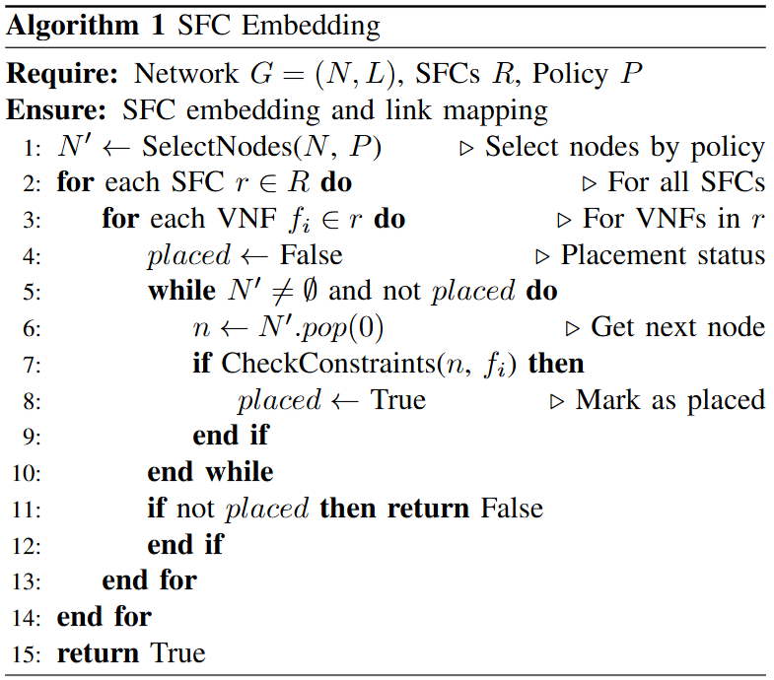
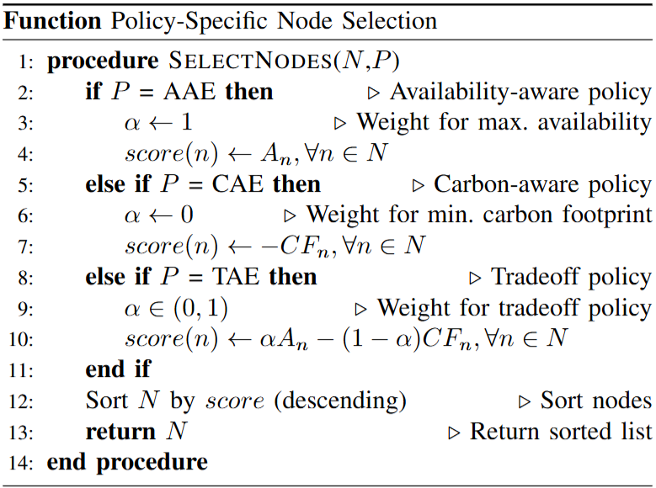
Network Placement Algorithms

Slide 15
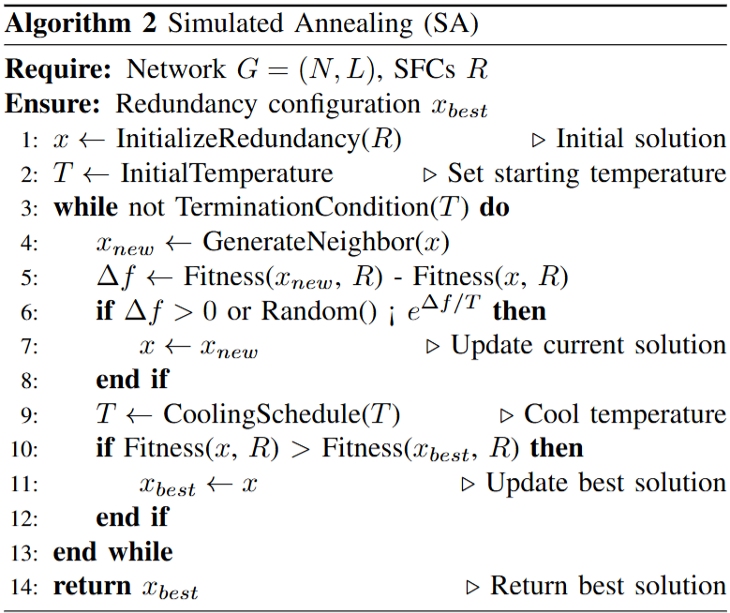
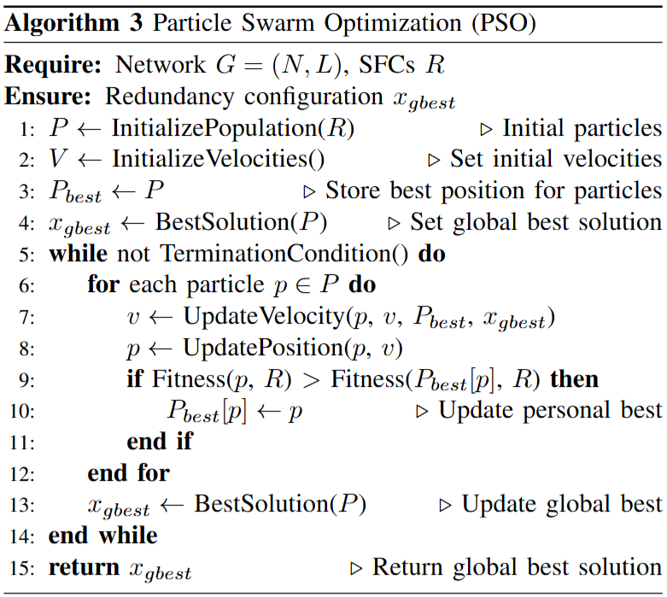
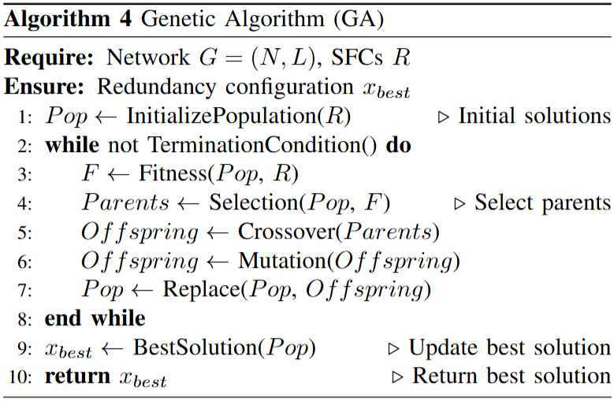
Network Allocation Algorithm (SA, PSO, GA)

Slide 16

Optimal Value of Weight (𝛼)
The availability and carbon footprint values are plotted against the different values of $α \left(weight\right)$
It is observed that the optimal balance between availability and carbon footprint is achieved at approximately:
$$α=0.4$$

Slide 17
Comparison of Embedding Policies

Slide 18
Comparison of Embedding Policies
Availability-Aware Policy:
Focuses on maximizing availability by selecting the most reliable resources.
It achieves 96.04% availability but results in a high carbon footprint (18,568.8 kgCO₂).
Carbon-Aware Policy:
Prioritizes energy-efficient nodes to minimize carbon emissions.
37.6% lower carbon footprint but reduces availability by 3.7% compared to the availability-aware policy.
Tradeoff-Aware Policy:
Balances availability and energy efficiency.
Only 0.17% lower availability than availability-aware, but 37.6% lower carbon footprint.

Slide 19
Paper Writing Progress
Section | Status | Notes
Abstract | ✅ Done | Final metrics to be added
Introduction | ✅ Done | Completed
Related Works | ✅ Done | Completed
Problem Formulation | ✅ Done | Completed
Methodology | ✅ Done | Completed
Results & Analysis | ✅ Done | Completed (A few additional metrics will be included by next meeting)
Conclusion | 🟡 In Progress | Will be completed in next meeting

Slide 20
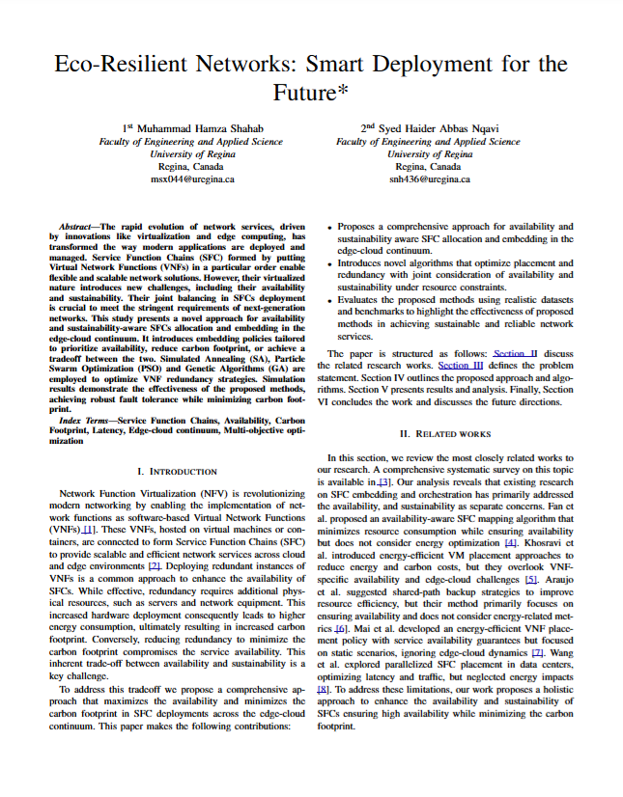
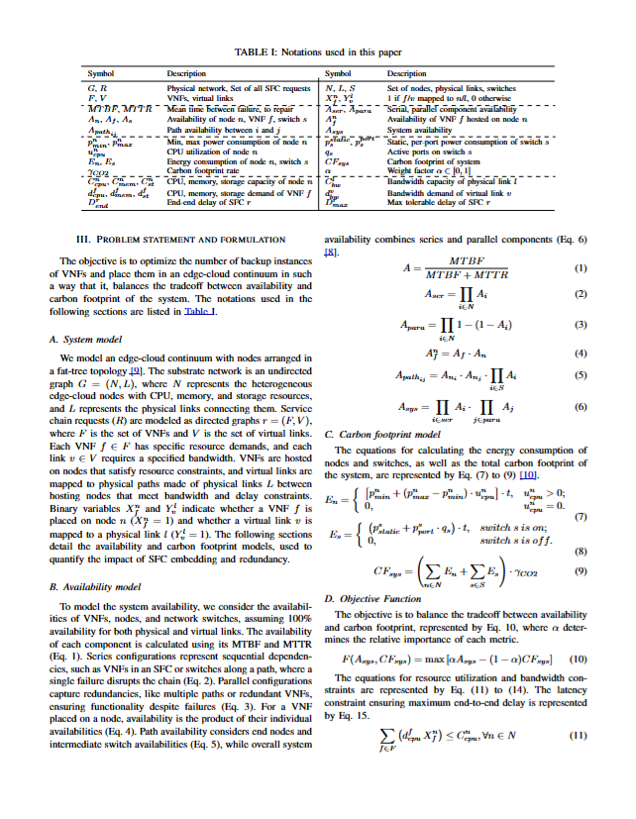
Notes:
Our project addresses the need for both reliable and sustainable networks. We're focusing on SaskTel as our primary user community.

Slide 21
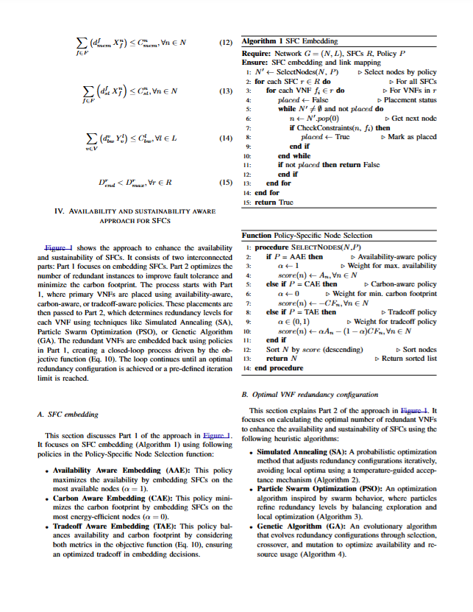
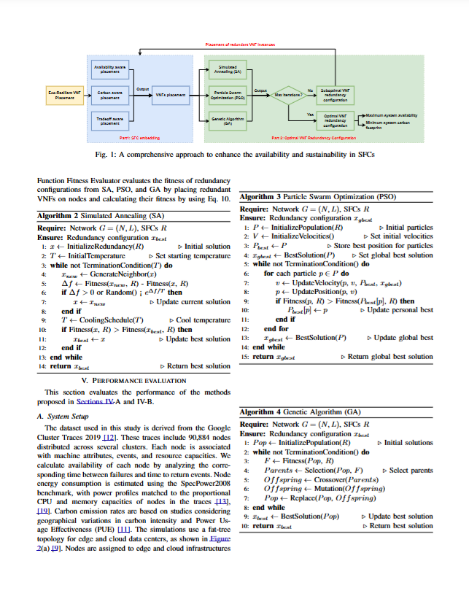
Notes:
Our project addresses the need for both reliable and sustainable networks. We're focusing on SaskTel as our primary user community.

Slide 22
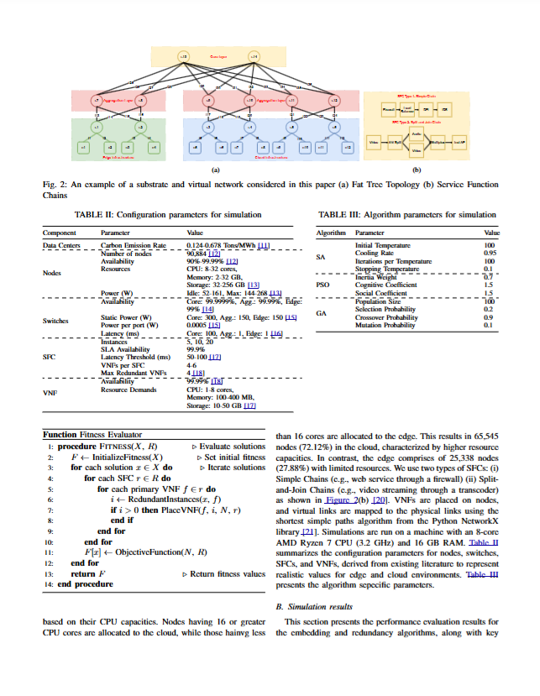
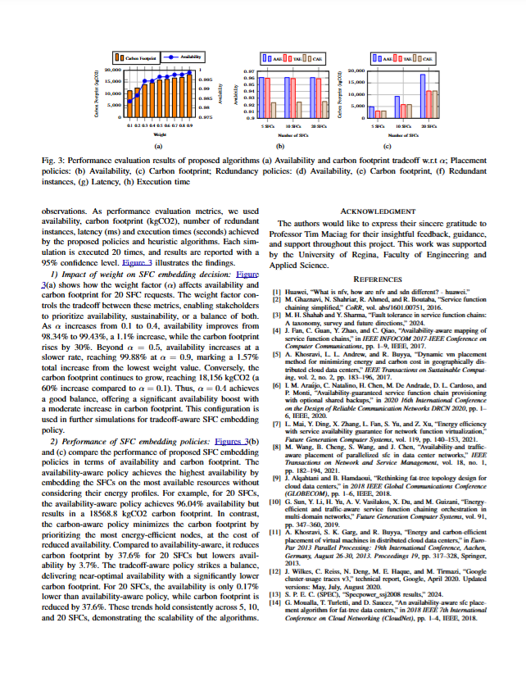
Notes:
Our project addresses the need for both reliable and sustainable networks. We're focusing on SaskTel as our primary user community.

Slide 23
References
Wang, Meng, et al. "Availability-and traffic-aware placement of parallelized SFC in data center networks." IEEE Transactions on Network and Service Management 18.1 (2021): 182-194.
Sun, Gang, et al. "Energy-efficient and traffic-aware service function chaining orchestration in multi-domain networks." Future Generation Computer Systems 91 (2019): 347-360.
https://www.iea.org/data-and-statistics/data-tools/greenhouse-gas-emissions-from-energy-data-explorer
Greenberg, Steve, et al. "Best practices for data centers: Lessons learned from benchmarking 22 data centers." Proceedings of the ACEEE summer study on energy efficiency in buildings in Asilomar, CA. ACEEE, August 3 (2006): 76-87.
US Department of Energy, Appendix F, Electricity Emission Factors, http://www.eia.doe.gov/oiaf/1605/pdf/Appendix
Khosravi, Atefeh, Saurabh Kumar Garg, and Rajkumar Buyya. "Energy and carbon-efficient placement of virtual machines in distributed cloud data centers." Euro-Par 2013 Parallel Processing: 19th International Conference, Aachen, Germany, August 26-30, 2013. Proceedings 19. Springer Berlin Heidelberg, 2013.
Asdikian, Jean Pierre, et al. "Service Function Chain Resource Allocation and Offloading in Constrained Edge-Cloud Optical Networks." 2024 24th International Conference on Transparent Optical Networks (ICTON). IEEE, 2024.
Vishesh, P., et al. "Optimized Placement of Service Function Chains in Edge Cloud with LSTM and ILP." SN Computer Science 6.1 (2024): 44.
Khoshkholghi, Mohammad Ali, et al. "Service function chain placement for joint cost and latency optimization." Mobile Networks and Applications 25.6 (2020): 2191-2205.

Slide 24


Thank You - Let’s Build Sustainable Networks!
Project Link: https://github.com/hamzashahab1610/ENSE-805-Project-Eco-Resilient-Networks.git
Contact:
Email: msx044@uregina.ca
LinkedIn: https://www.linkedin.com/in/hamzashahab1610/
GitHub: https://github.com/hamzashahab1610

